Slide 1
Introduction to Python
A user friendly programming language powered by a powerful, effecient and low-level backend programming language.

Slide 2
Summary
What is Python?
Syntax
Types and Operators
Control Flow
Functions
Classes
Tools

Slide 3
What is Python?
Python is multi-purpose language
Object Oriented
Interpreted
Main focus on accessibility and productivity
Provides bindings for libraries written in other languages
Cross platform
Pssst... Python forces you to be a better programmer

Slide 4
Syntax

Slide 5
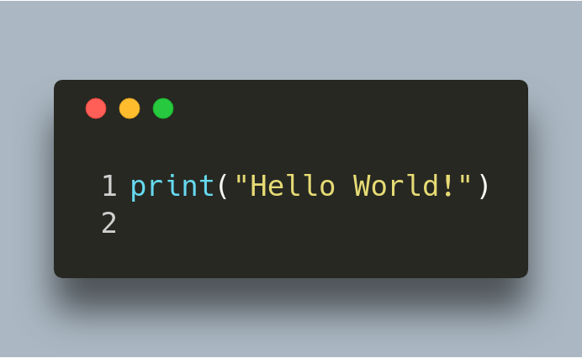
Hello World!

Slide 6
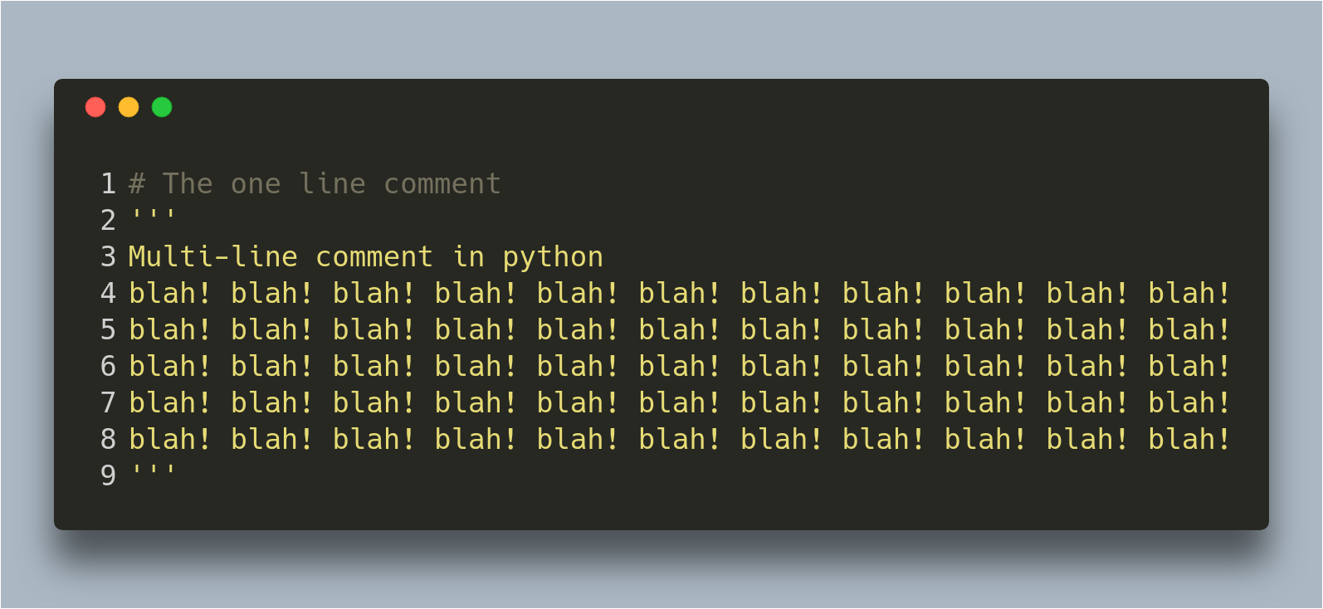
Comments

Slide 7
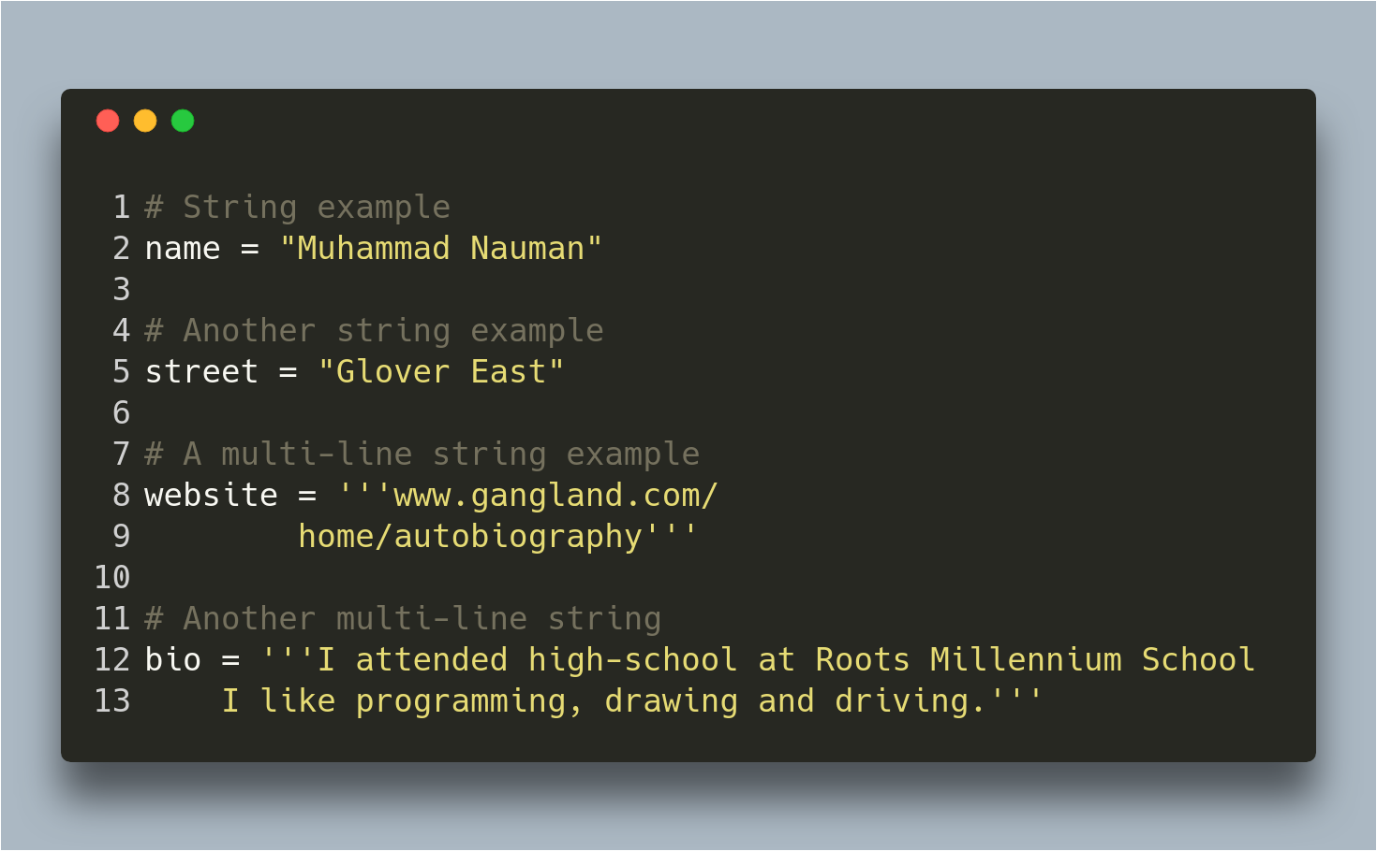
Strings

Slide 8
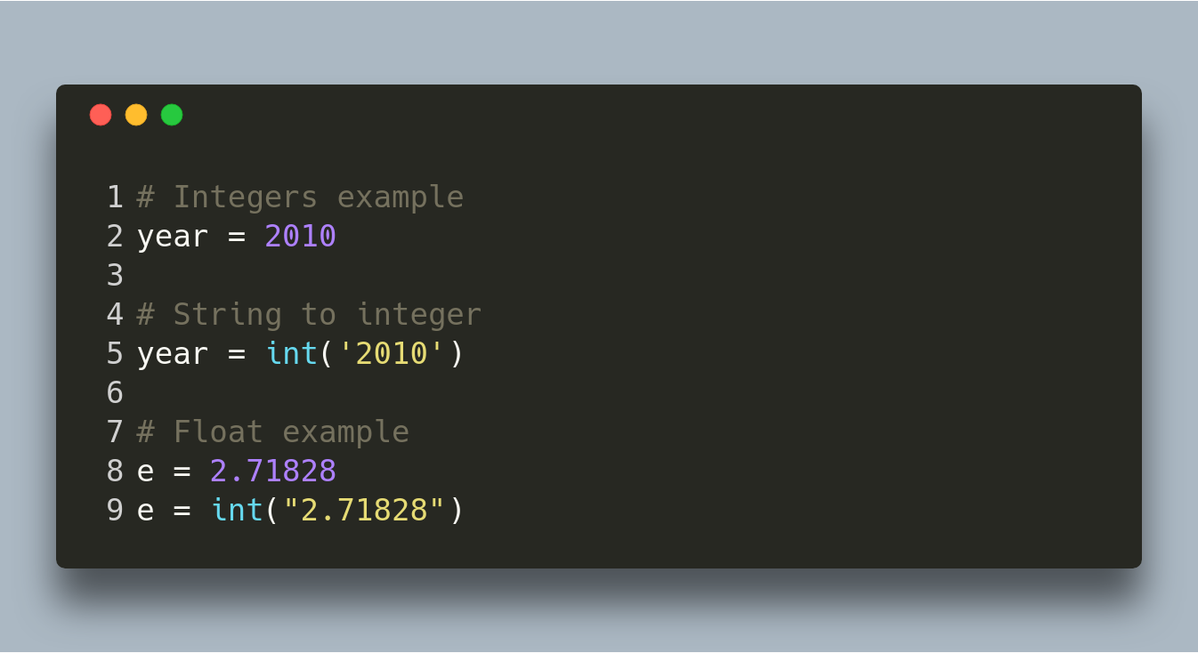
Numbers

Slide 9
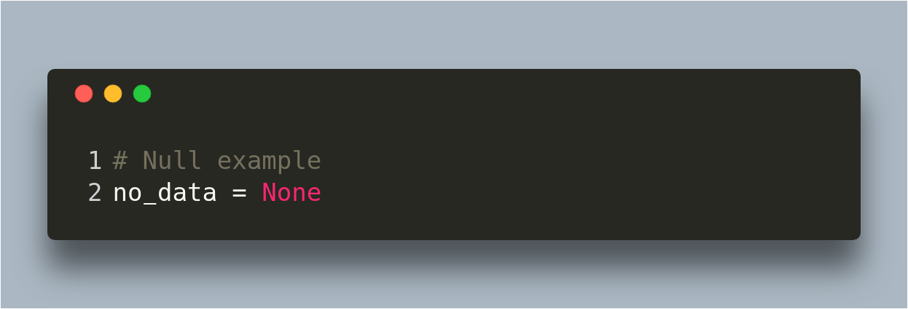
Null

Slide 10
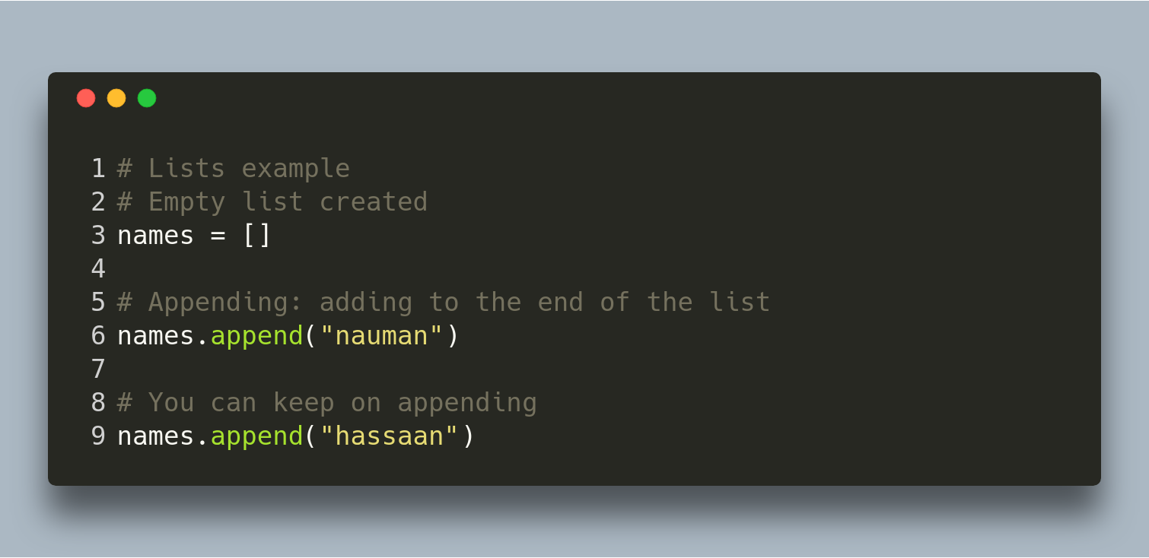
Lists

Slide 11
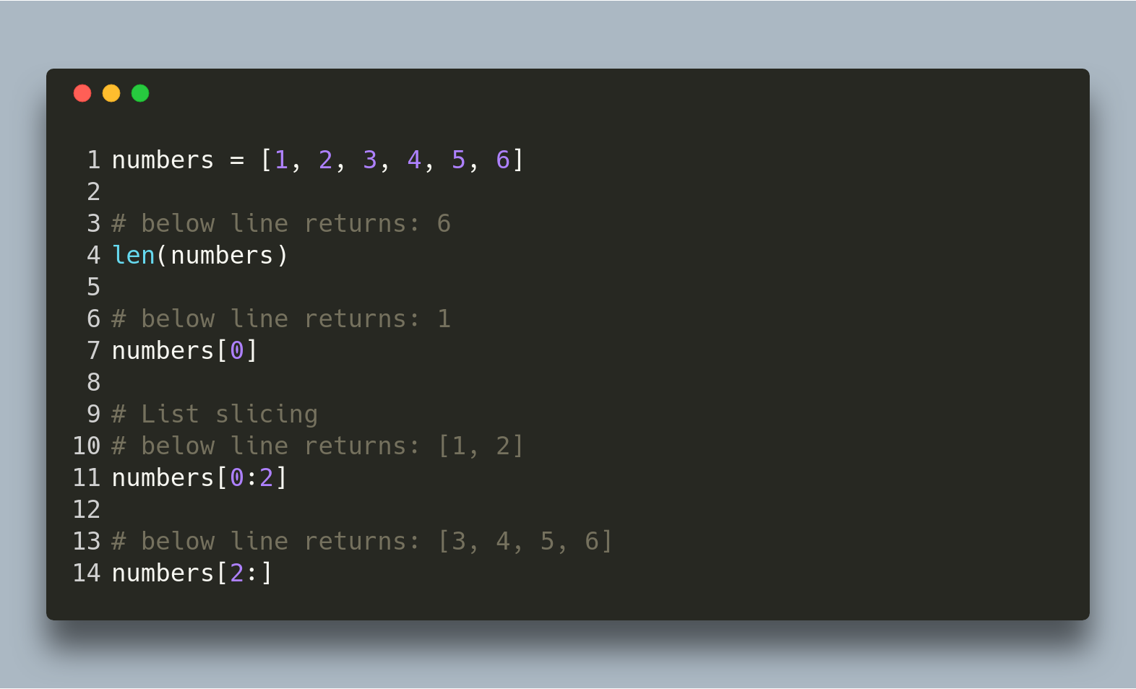
Lists Further

Slide 12
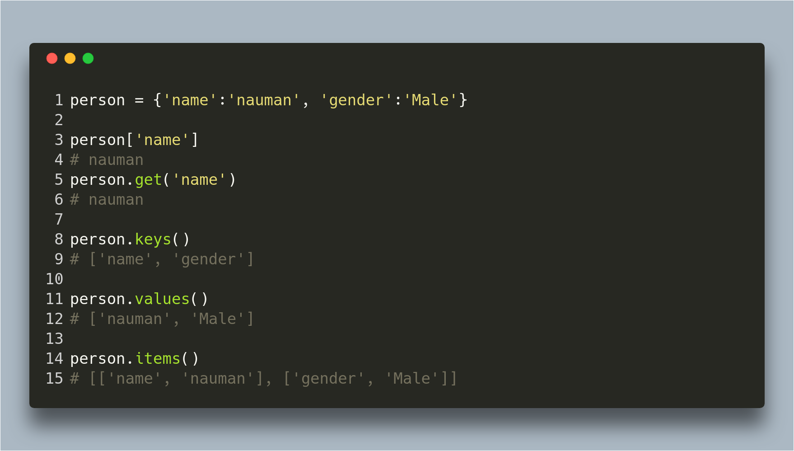
Dictionaries

Slide 13
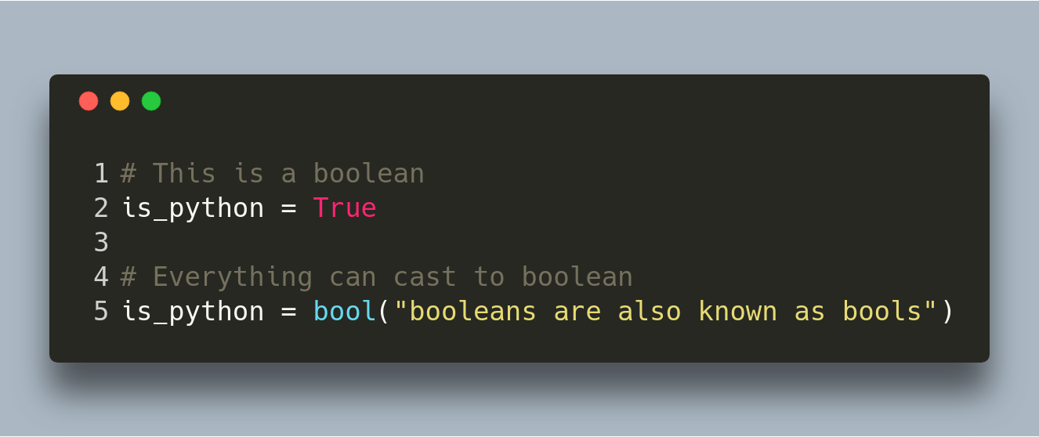
Booleans

Slide 14
Operators

Slide 15
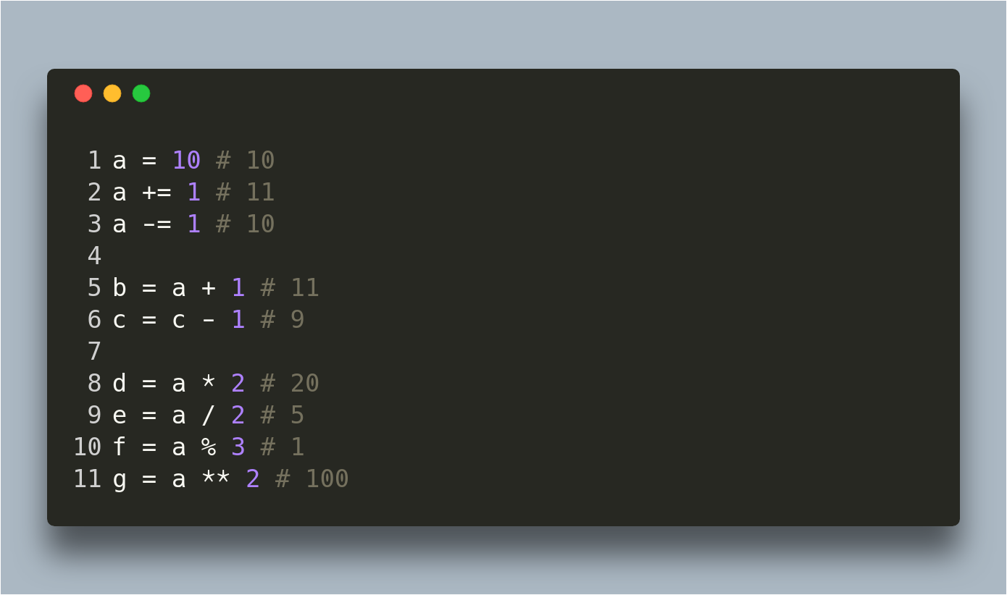
Arithmetic

Slide 16
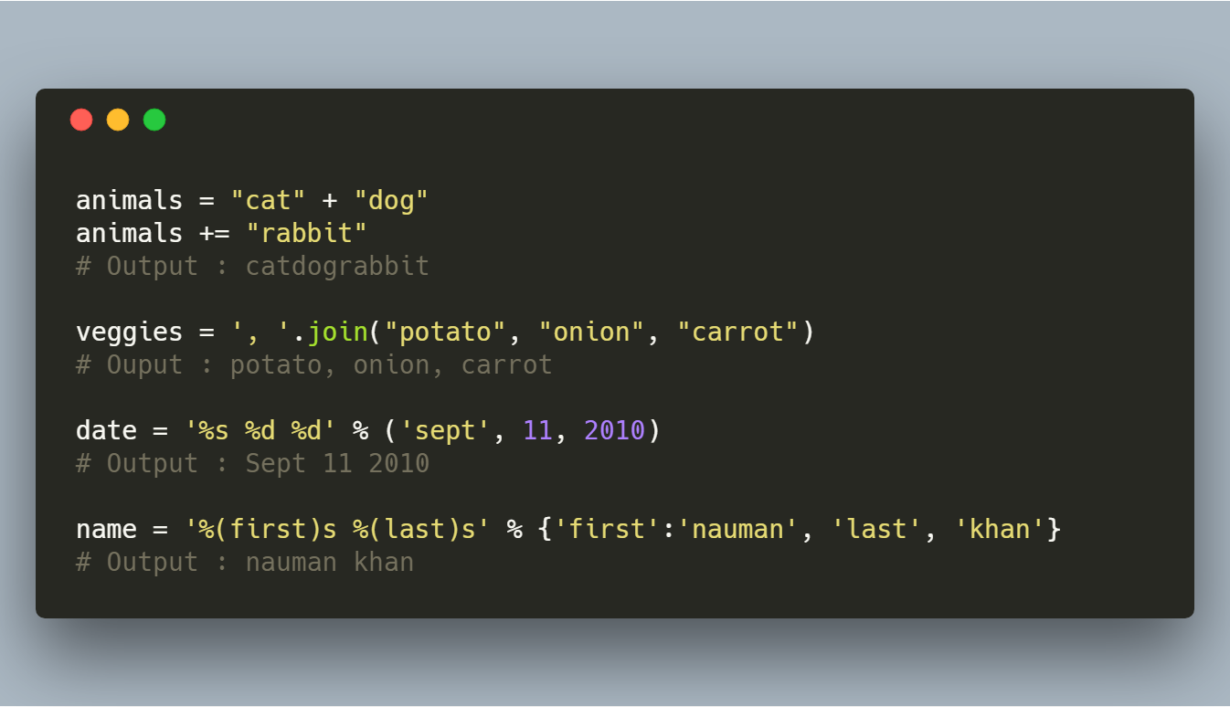
String Manipulation

Slide 17
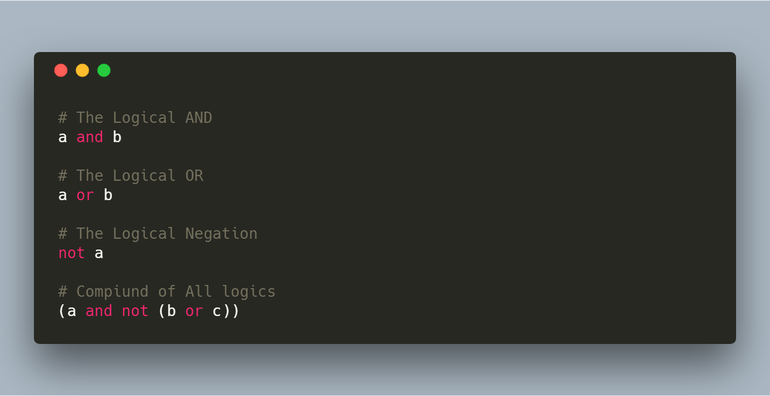
Logical Comparison

Slide 18
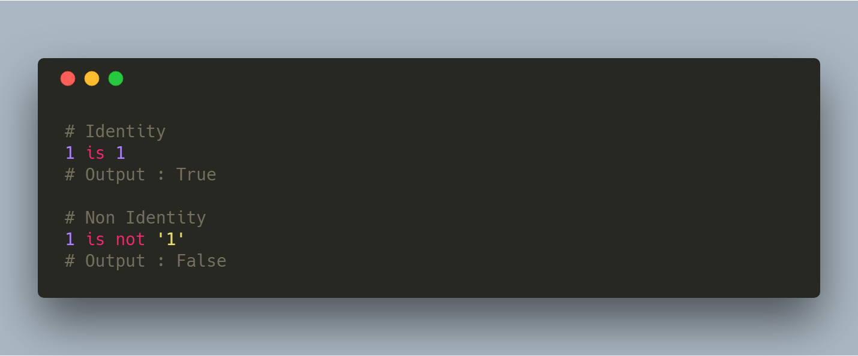
Identity Comparison

Slide 19
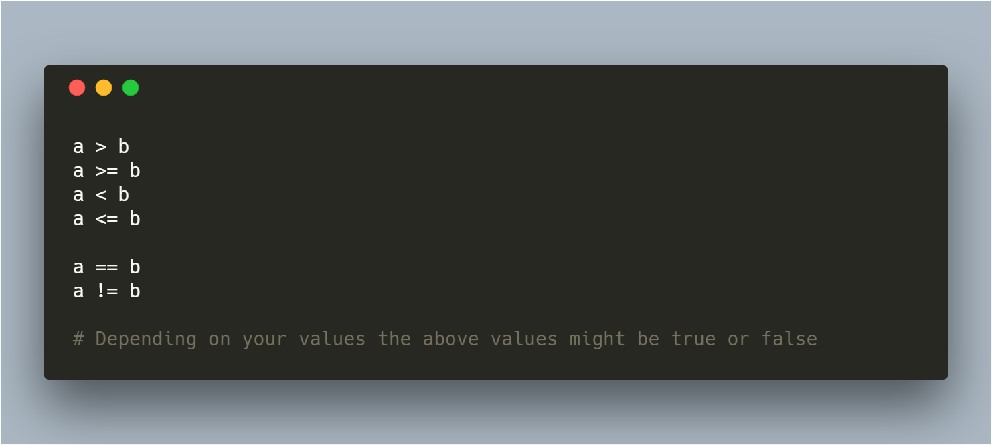
Arithmetic Comparison

Slide 20
Flow Control

Slide 21
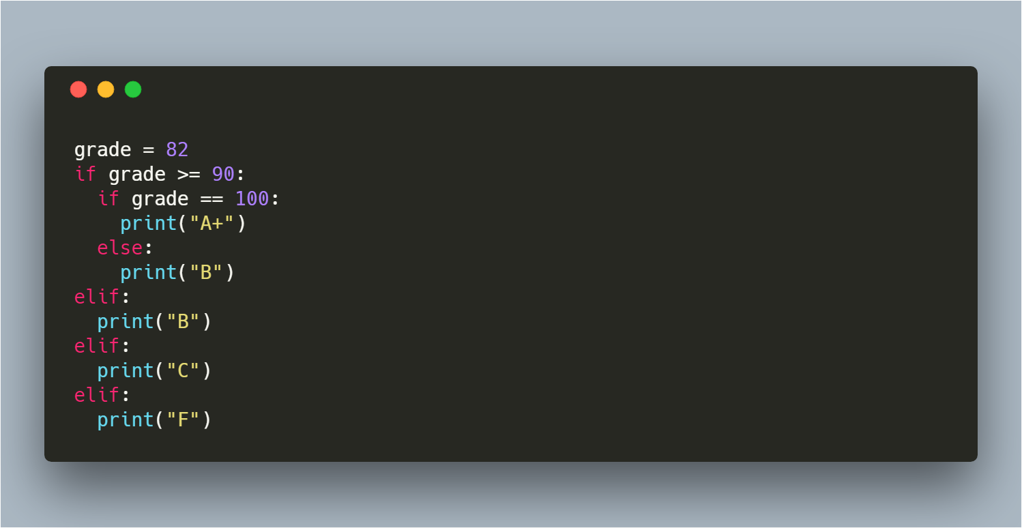
Conditionals

Slide 22
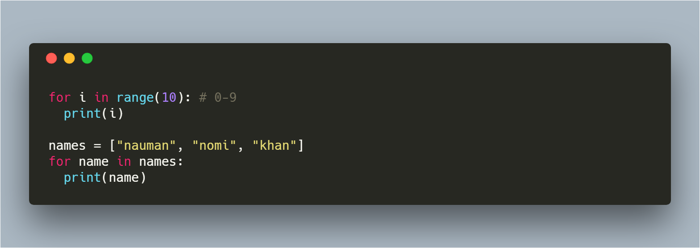
For Loops

Slide 23
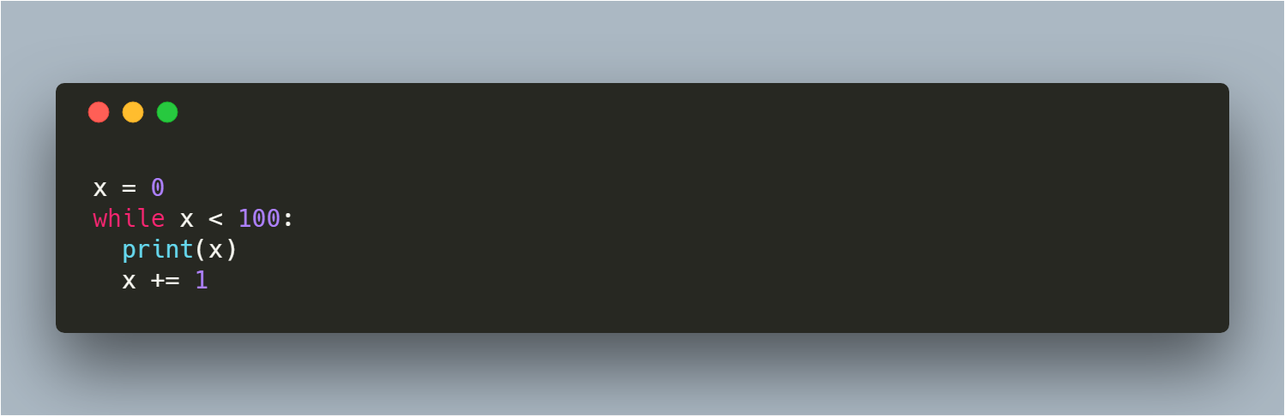
While Loop

Slide 24
Functions

Slide 25
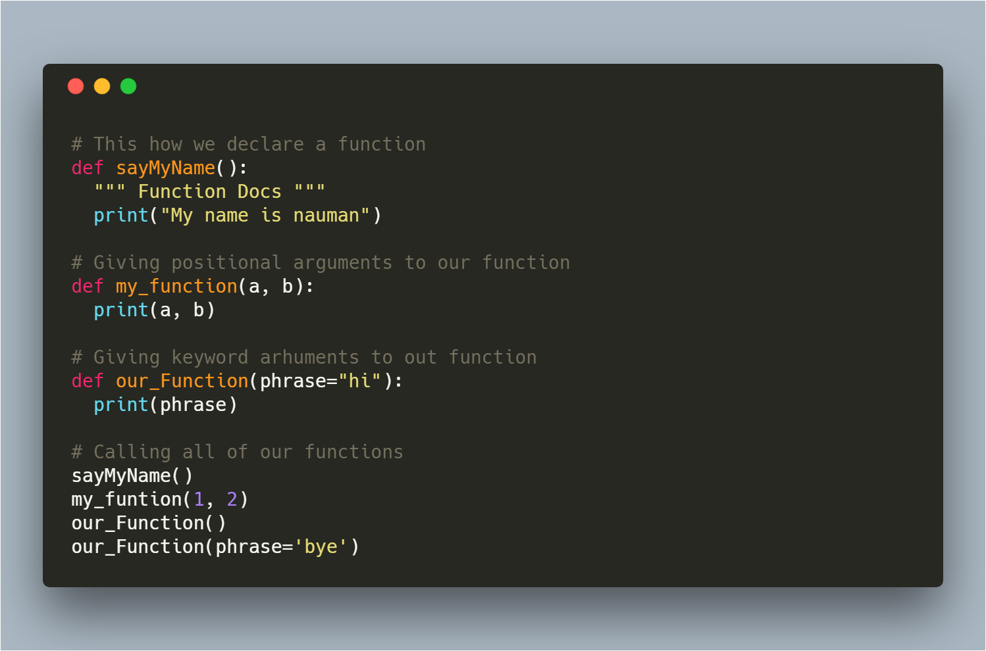
Declaring a Function

Slide 26
Classes

Slide 27
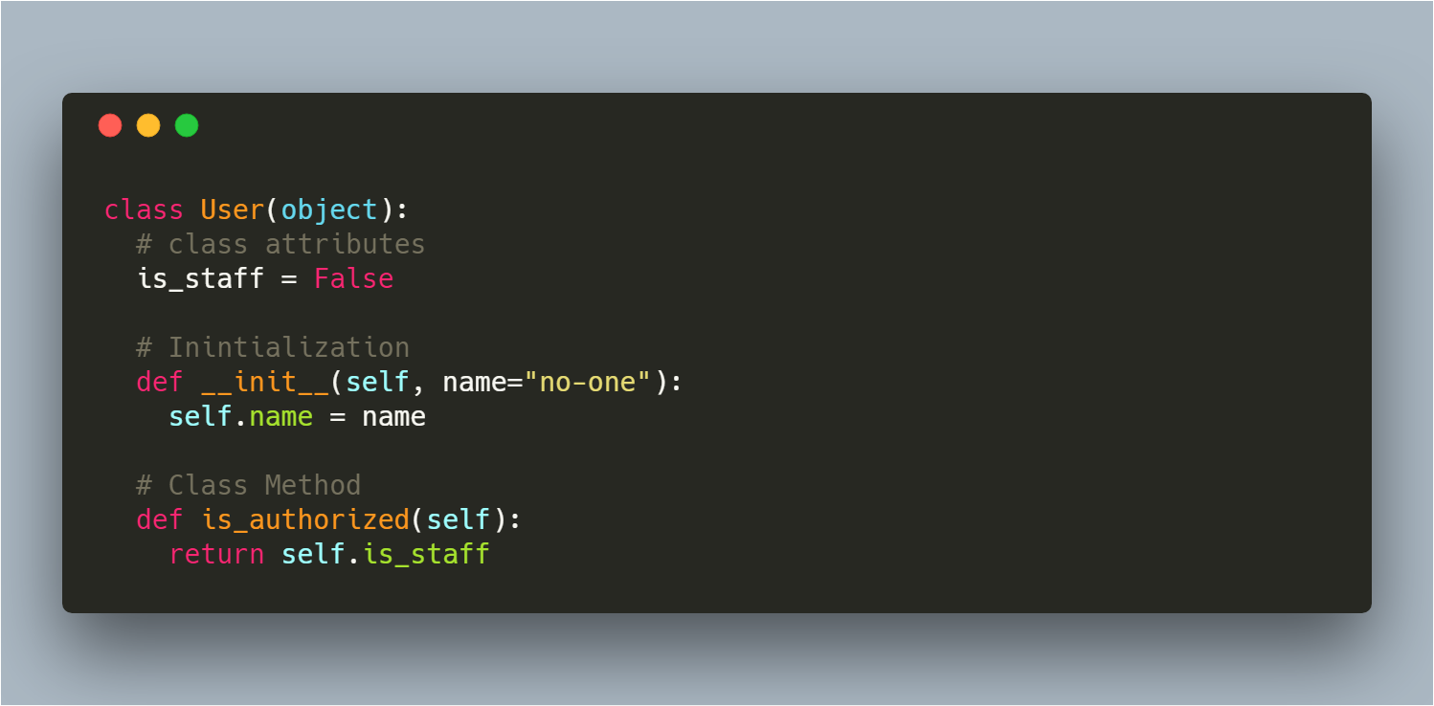
Class Design

Slide 28
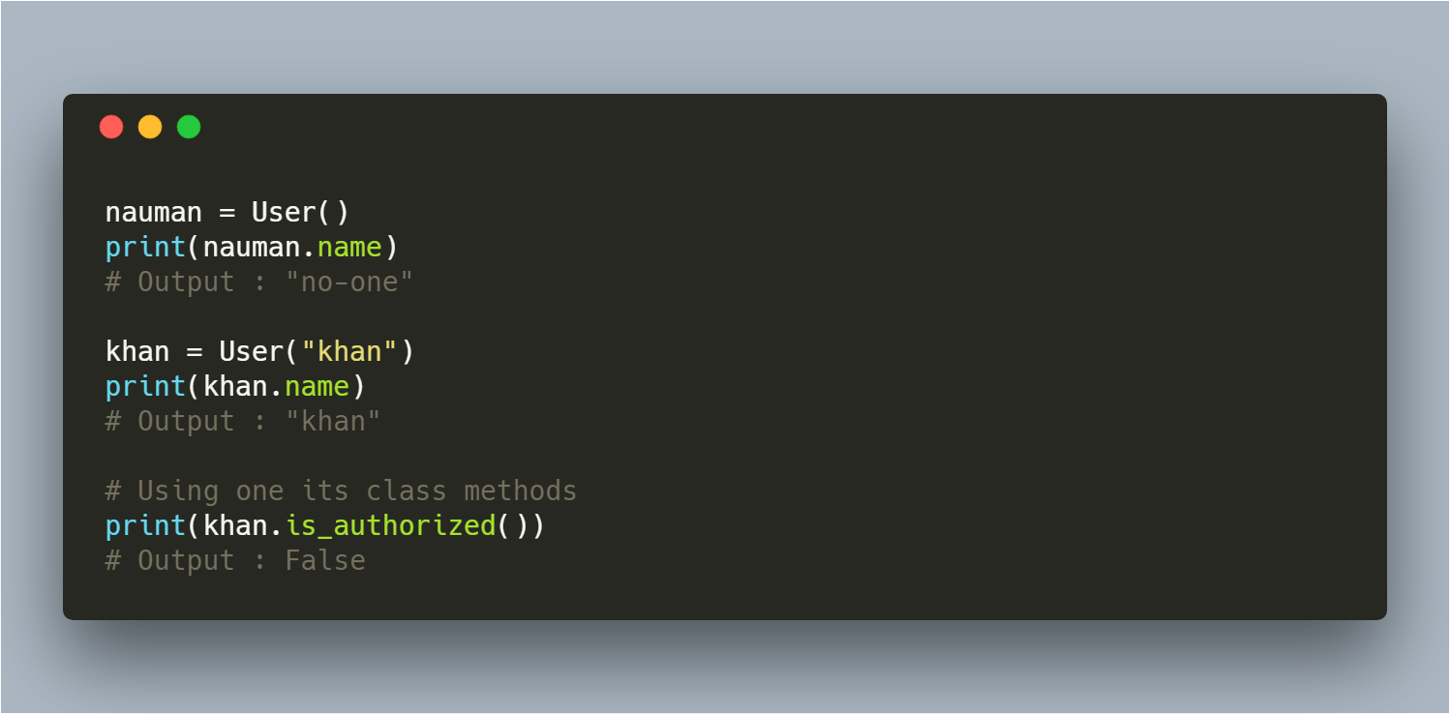
Class Usage

